Slide 1

DEPARTMENT OF INFORMATION TECHNOLOGY
24ITT32 - PROGRAMMING IN JAVA
INDIVIDUAL PROJECT ON ACADEMIC MANAGEMENT SYSTEM
P R O J E C T R E P O R T
Submitted by
YASHVANTH PS
25ITR179

Slide 2
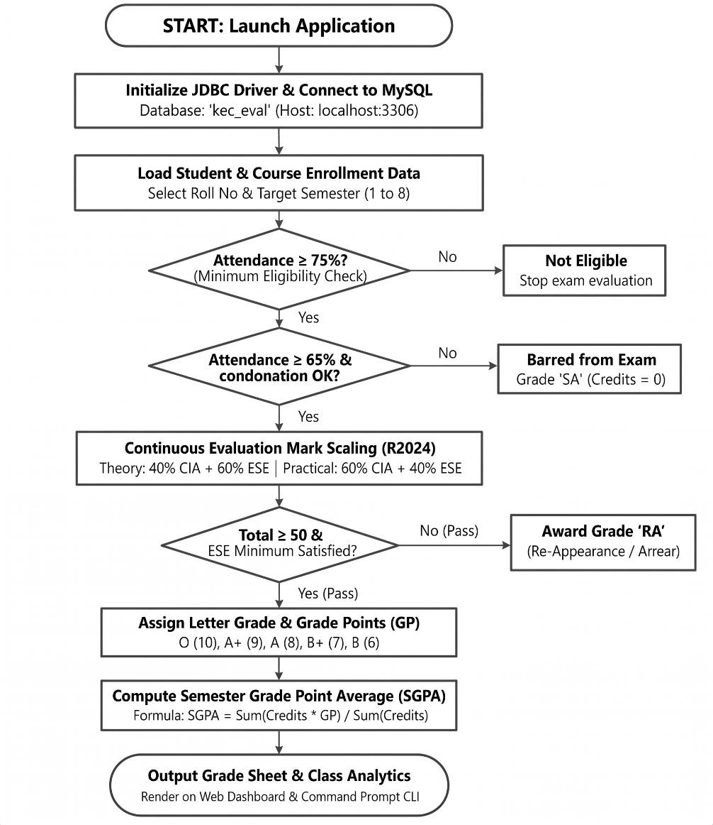
JAVA ASSIGNMENT
AIM:
Development of Kongu Engineering College (R2024) Student Academic & Continuous Evaluation System using Java JDBC.
OBJECTIVE:
Design and develop a database-driven Java application using JDBC to manage student records, perform incremental marks entry (Continuous Internal Assessments and End Semester Examinations), enforce attendance eligibility rules, and generate formal academic performance reports according to Kongu Engineering College (Autonomous) - Regulation 2024. System Requirements & Specifications.
FLOW CHART:

Slide 3
PROCEDURE:
Load the MySQL Connector/J driver to enable communication between the Java application and the MySQL database.
Establish a connection to the kec_eval database running on the local MySQL server using DriverManager.getConnection().
Store and retrieve student details, including roll number, name, department, and semester, along with course information such as course code, title, credits, and course type.
Enroll students in semester courses, record the number of classes held and attended, and calculate the attendance percentage.
Verify examination eligibility based on attendance percentage. Students with 75% or above are eligible, those with 65%–74% require medical condonation verification, and those below 65% are marked as Shortage of Attendance (SA).
Record CIA-1, CIA-2, and assignment marks, and calculate the scaled internal assessment marks according to the specified theory and practical course weightages.
Record end-semester examination marks out of 100, verify the minimum passing requirements, and scale the marks according to the applicable theory and practical .
Calculate the total marks by combining scaled CIA and ESE marks. Assign letter grades and grade points according to the specified grading scale, marking students as RA if they fail the examination or score below the required passing mark.
Generate student grade sheets, attendance shortage reports, and department-wise pass percentage reports. Display the results through the interactive web dashboard and the command prompt console.

Slide 4
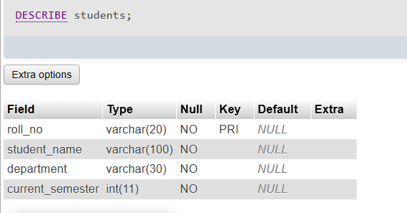
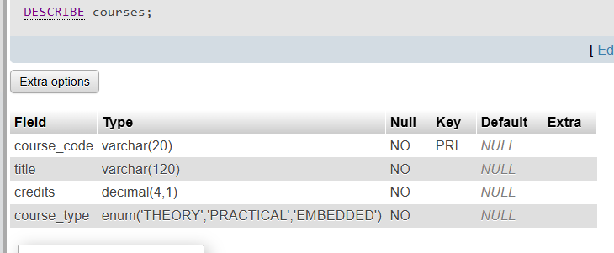
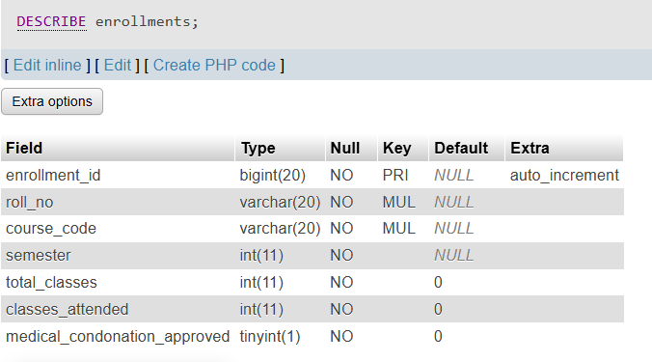
DATABASE SCHEMA:
1.STUDENTS TABLE:
2. COURSES TABLE:
3. ENROLLMENTS TABLE:

Slide 5
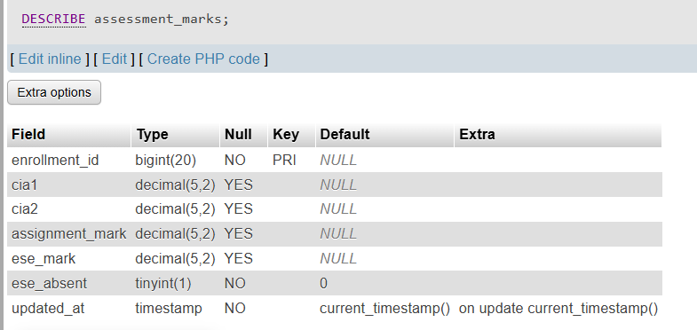
4. ASSESSMENT MARKS TABLE:
SOURCE CODE:
MAINAPP JAVA:
import java.sql.SQLException;
import java.util.Scanner;
public class MainApp {
private static final Scanner sc = new Scanner(System.in);
private static final StudentDAO studentDAO = new StudentDAO();
private static final AcademicDAO academicDAO = new AcademicDAO();
public static void main(String[] args) {
printBanner();
if (!DBConnection.testConnection()) {
System.err.println("Unable to connect to MySQL. Check service, kec_academic schema and DB credentials.");
return;
}
System.out.println("Database connected successfully."); boolean running = true;
while (running) {
printMainMenu();
try {
switch (readInt("Enter Choice (0-10): ")) {
case 1: registerStudent(); break; case 2: addCourse(); break;
case 3: enrollStudent(); break; case 4: attendance(); break;
case 5: marksMenu(); break; case 6: markSheet(); break;
case 7: academicDAO.printAttendanceDefaulters(); break; case 8: classSummary(); break;
case 9: studentDAO.showStudents(); studentDAO.showCourses(); break;
case 10: seedData(); break;
case 0: running = false; System.out.println("Goodbye!"); break;
default: System.out.println("Invalid choice. Enter 0-10.");
}
} catch (Exception e) { System.err.println("Error: " + e.getMessage()); } if (running) pause();
}
} private static void printBanner() {
System.out.println(" STUDENT ACADEMIC & CONTINUOUS EVALUATION SYSTEM"); System.out.println("==============================================================");
}
private static void printMainMenu() {
System.out.println("\n1. Student Registration 2. Course Catalog"); System.out.println("3. Course Enrollment 4. Attendance");
System.out.println("==============================================================");

Slide 6
System.out.println("5. Incremental Marks 6. Mark Sheet / SGPA"); System.out.println("7. Attendance Defaulters 8. Class Summary");
System.out.println("9. View Students and Courses 10. Demo Data"); System.out.println("0. Exit");
}
private static void registerStudent() throws SQLException {
String roll = read("Roll Number: ").toUpperCase(); String name = read("Student Name: ");
String dept = read("Department: ").toUpperCase(); int sem = readInt("Semester (1-8): ");
studentDAO.addStudent(roll, name, dept, sem);
}
private static void addCourse() throws SQLException {
String code = read("Course Code: ").toUpperCase(); String title = read("Course Title: ");
double credits = readDouble("Credits: "); System.out.println("1.THEORY 2.PRACTICAL 3.EMBEDDED");
int choice = readInt("Course Type: ");
String type = choice == 2 ? "PRACTICAL" : choice == 3 ? "EMBEDDED" : "THEORY";
studentDAO.addCourse(code, title, credits, type);
}
private static void enrollStudent() throws SQLException {
studentDAO.enroll(read("Roll Number: ").toUpperCase(),
read("Course Code: ").toUpperCase(), readInt("Semester: "));
} private static void marksMenu() throws SQLException {
System.out.println("A. CIA Tests B. Assignment/Lab C. ESE"); System.out.println("D. Update One Mark E. View Marks");
String opt = read("Select A-E: ").toUpperCase(); String roll = read("Roll Number: ").toUpperCase();
String code = read("Course Code: ").toUpperCase(); int sem = readInt("Semester: ");
switch (opt) {
case "A":
academicDAO.recordPhase1CIA(roll, code, sem,
readOptionalDouble("CIA Test 1 (Enter to skip): "),
readOptionalDouble("CIA Test 2 (Enter to skip): "));
break;
case "B":
academicDAO.recordPhase2Assignment(roll, code, sem,
readOptionalDouble("Assignment/Lab mark: "));
break;
case "C":
boolean absent = yesNo("Absent in ESE? (y/n): ");
Double ese = absent ? null : readOptionalDouble("ESE mark: ");
academicDAO.recordPhase3ESE(roll, code, sem, ese, absent);
break;
case "D":
String component = read("Component (CIA1/CIA2/ASSIGNMENT/ESE): ").toUpperCase();
boolean isAbsent = component.equals("ESE") && yesNo("Absent? (y/n): ");
Double mark = isAbsent ? null : readOptionalDouble("Mark: ");
academicDAO.updateSingleAssessment(roll, code, sem, component, mark, isAbsent);
break;
case "E":
showMarks(roll, code, sem);
break;
default: System.out.println("Invalid selection.");
}
}
private static void showMarks(String roll, String code, int sem) throws SQLException {
AcademicDAO.EnrollmentInfo i = academicDAO.getEnrollmentDetails(roll, code, sem);
if (i == null) { System.out.println("No enrollment record found."); return; }
System.out.printf("Student: %s (%s), Dept: %s, Sem: %d%n", i.studentName, i.rollNo, i.department, i.semester);
System.out.printf("Course: %s - %s (%s, %.1f credits)%n", i.courseCode, i.courseTitle, i.courseType, i.credits);
System.out.printf("Attendance: %d/%d (%.2f%%) Status: %s%n", i.classesAttended, i.totalClasses, i.attendancePct, i.attendanceStatus);
System.out.printf("CIA1: %s | CIA2: %s | Assignment: %s | CIA Avg: %.2f%n",
value(i.cia1), value(i.cia2), value(i.assignmentMark), i.ciaRaw);
System.out.printf("ESE: %s | Absent: %s | Grade: %s | GP: %d | Result: %s%n",
value(i.eseMark), i.eseAbsent ? "YES" : "NO", i.grade, i.gradePoint, i.resultStatus);
}

Slide 7
private static String value(Double n) { return n == null ? "--" : String.format("%.2f", n); }
private static void markSheet() throws SQLException {
academicDAO.printStudentMarkSheet(read("Roll Number: ").toUpperCase(), readInt("Semester: "));
}
private static void classSummary() throws SQLException {
academicDAO.printClassPerformanceSummary(readInt("Semester to summarize (1-8): "));
}
private static void seedData() throws SQLException {
if (yesNo("Insert sample students, courses, enrollments and marks? (y/n): "))
academicDAO.seedDemoData();
}
private static String read(String prompt) {
System.out.print(prompt); return sc.nextLine().trim();
}
private static int readInt(String prompt) {
while (true) {
try { return Integer.parseInt(read(prompt)); }
catch (NumberFormatException e) { System.out.println("Enter a valid whole number."); }
}
}
private static double readDouble(String prompt) {
while (true) {
try { return Double.parseDouble(read(prompt)); }
catch (NumberFormatException e) { System.out.println("Enter a valid number."); }
}
}
private static Double readOptionalDouble(String prompt) {
while (true) {
String s = read(prompt);
if (s.isEmpty()) return null;
try { return Double.parseDouble(s); }
catch (NumberFormatException e) { System.out.println("Enter a number or press Enter to skip."); }
}
}
private static boolean yesNo(String prompt) {
while (true) {
String s = read(prompt).toLowerCase();
if (s.equals("y") || s.equals("yes")) return true;
if (s.equals("n") || s.equals("no")) return false;
System.out.println("Enter y or n.");
}
}
private static void pause() {
System.out.print("Press Enter to return to menu...");
sc.nextLine();
}
}

Slide 8
DB CONNECTION.JAVA:
import java.sql.Connection;
import java.sql.DriverManager;
import java.sql.SQLException;
/**
* DBConnection - JDBC connection manager for KEC Academic System.
* Connects to MySQL using MySQL Connector/J driver.
*/
public final class DBConnection {
private static final String DEFAULT_URL =
"jdbc:mysql://localhost:3306/kec_academic?useSSL=false&allowPublicKeyRetrieval=true&serverTimezone=UTC";
private static final String DEFAULT_USER = "root";
private static final String DEFAULT_PASSWORD = "";
static {
try {
Class.forName("com.mysql.cj.jdbc.Driver");
} catch (ClassNotFoundException e) {
System.err.println("[DBConnection] MySQL Connector/J driver not found in classpath.");
}
}
private DBConnection() {}
public static Connection getConnection() throws SQLException {
String url = System.getenv().getOrDefault("KEC_DB_URL", DEFAULT_URL);
String user = System.getenv().getOrDefault("KEC_DB_USER", DEFAULT_USER);
String pass = System.getenv().getOrDefault("KEC_DB_PASSWORD", DEFAULT_PASSWORD);
return DriverManager.getConnection(url, user, pass);
}
public static boolean testConnection() {
try (Connection conn = getConnection()) {
return conn != null && !conn.isClosed();
} catch (SQLException e) {
return false;
}
}
}

Slide 9
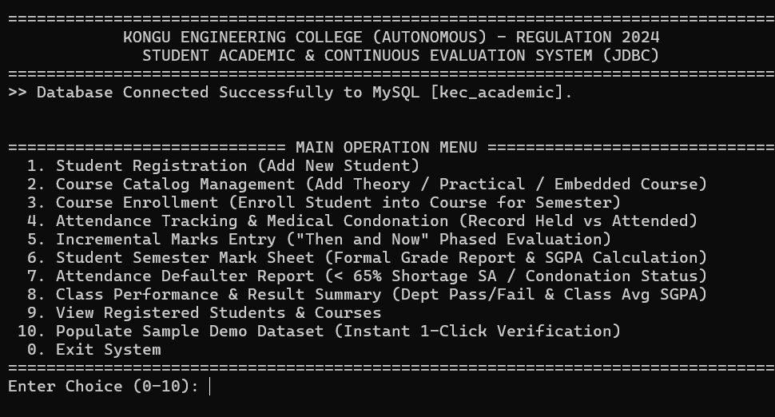
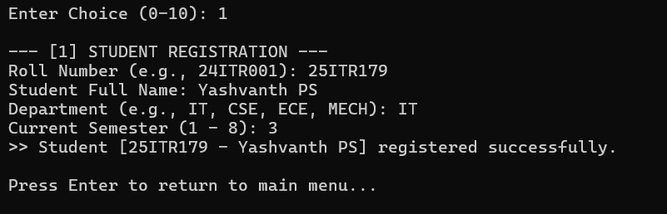
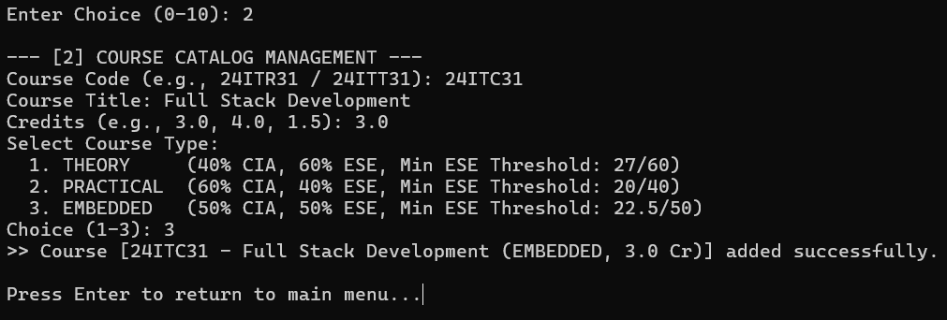
OUTPUT SCREENSHOTS:
MAIN MENU:
STUDENT & COURSE MANAGEMENT:
1.STUDENT REGISTRATION:
2. COURSE CATALOG:

Slide 10
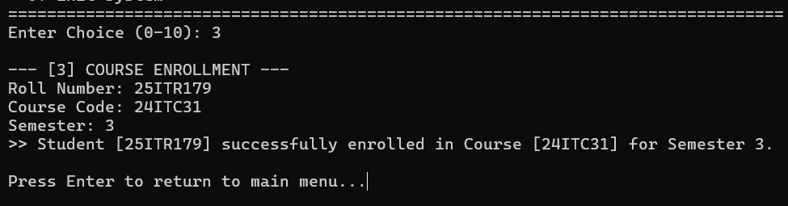
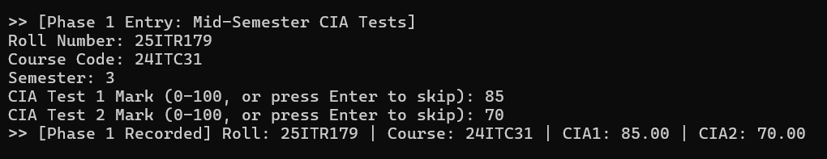
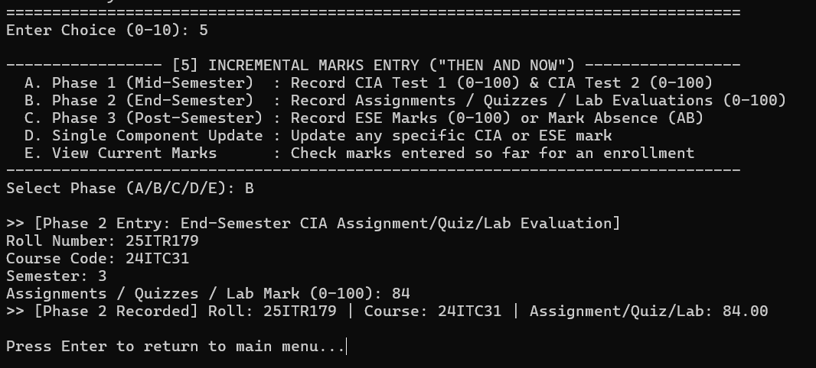
3. COURSE ENROLLMENT :
INCREMENTAL MARKS ENTRY:
1.PHASE 1 (MID-SEMESTER):
2.PHASE 2 (END OF SEMESTER - CIA):

Slide 11
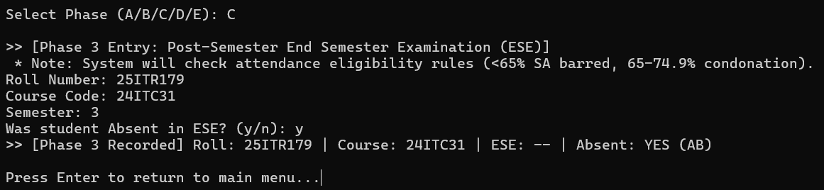
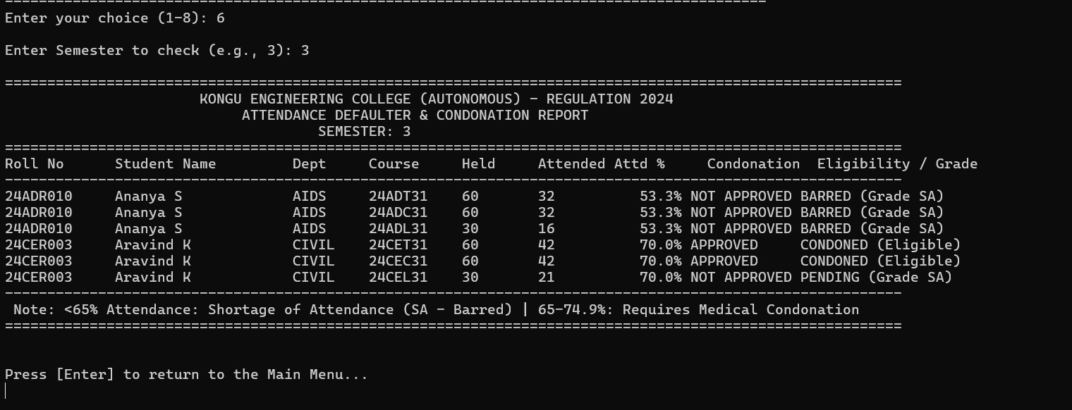
3. PHASE 3 (POST SEMESTER):
ATTENDANCE & GRADING RULES:
1.ATTENDANCE FILTER:

Slide 12
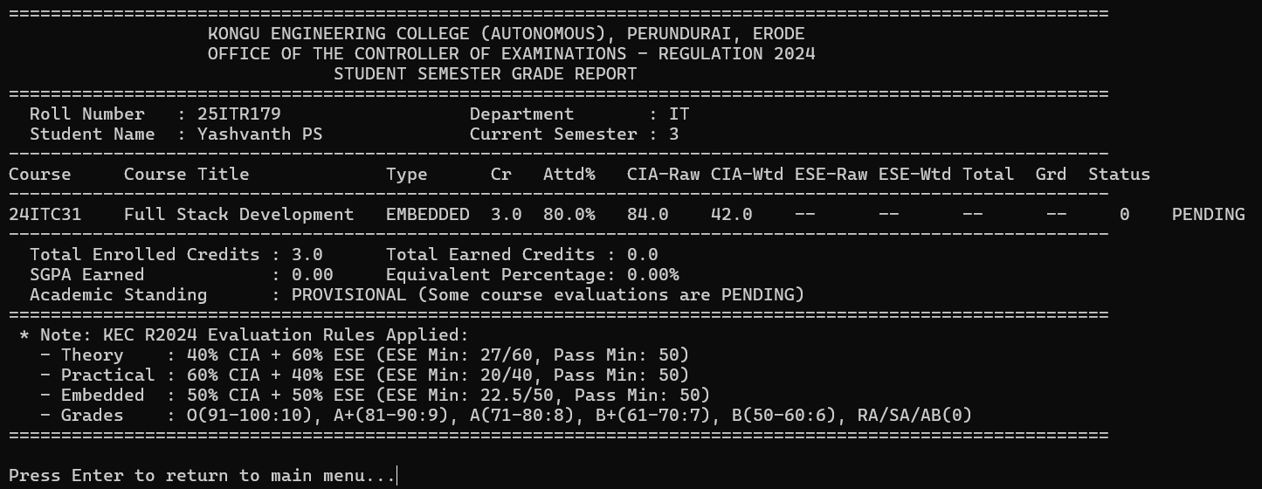
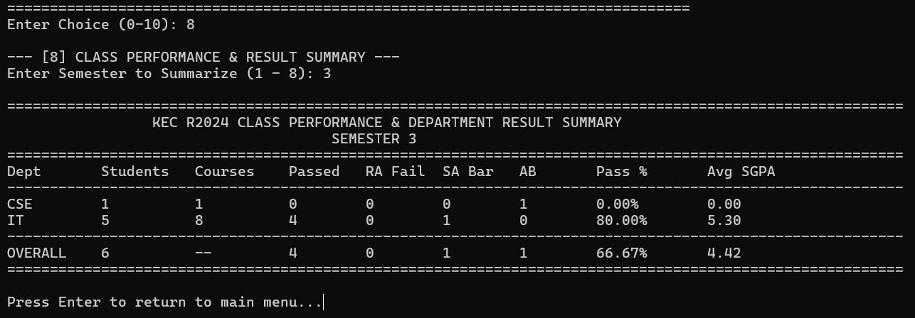
STUDENT SEMESTER MARK SHEET:
DEPARTMENT WISE CLASS PERFORMANCE & RESULT SUMMARY:

Slide 13
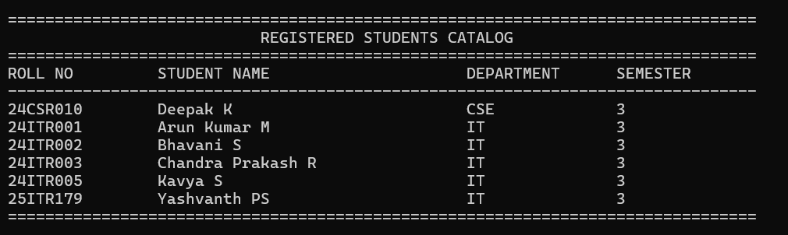
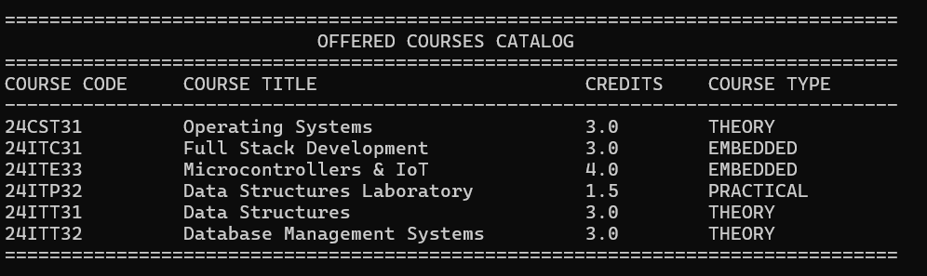
DATABASE:
STUDENTS DATABASE:
COURSES DATABASE:

Slide 14
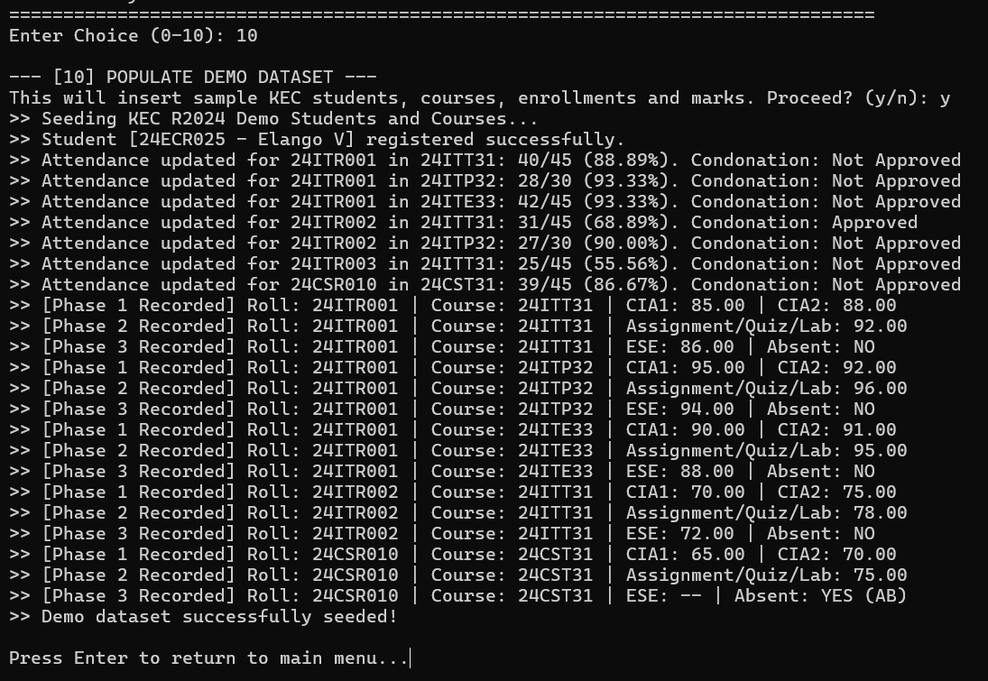
ENROLLMENTS DATABASE:
RESULT:
Thus, the Student Academic and Continuous Evaluation System for Kongu Engineering College (Autonomous) Regulation 2024 was successfully designed, developed, and tested using Java (JDBC) and MySQL. The system accurately automates the calculation of Continuous Internal Assessments (CIA), End Semester Examinations (ESE), Letter Grades, Attendance Eligibility, and Semester Grade Point Average (SGPA).

Slide 15
REFERENCES:
Oracle, Java SE Documentation – JDBC Overview and Architecture. https://docs.oracle.com/javase/8/docs/technotes/guides/jdbc/ .
Oracle, Java SE API – HttpServer. https://docs.oracle.com/en/java/javase/17/docs/api/jdk.httpserver/com/sun/net/httpserve r/HttpServer.html .
Oracle, MySQL 8.0 Reference Manual. https://dev.mysql.com/doc/refman/8.0/en/ .
Oracle, MySQL Connector/J Developer Guide. https://dev.mysql.com/doc/connector-j/8.0/en/ .
University Grants Commission, Guidelines for Choice Based Credit System (CBCS). https://www.ugc.gov.in/pdfnews/8023719_Guidelines-for-CBCS.pdf .
Chart.js, Chart.js Documentation. https://www.chartjs.org/docs/latest/ .
Tailwind CSS, Tailwind CSS Documentation. https://tailwindcss.com/docs .
GeeksforGeeks, Establishing JDBC Connection in Java. https://www.geeksforgeeks.org/establishing-jdbc-connection-in-java/ .
YouTube, Java JDBC with MySQL Tutorial Videos. https://www.youtube.com/results?search_query=Java+JDBC+MySQL+tutorial .
Anthropic, Claude AI Assistant (used for project ideas and guidance). https://claude.ai/ .
GITHUB:
https://github.com/yashvanth111/Student-Academic-Continuous-Evaluation-System-using-Java-JDBC.git

